Slide 1
HNDIT2417
Mobile Application Development
List View

Slide 2
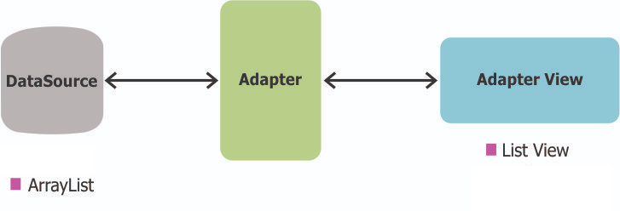
List View
ListView is a view which groups several items and display them in vertical scrollable list.
The list items are inserted to the list using an Adapter that pulls content from a source

Slide 3
ArrayAdapter
Used when data source is an array
First argument this is the application context. Most of the case, keep it this.
Second argument is layout defined in XML file.
Final argument is an array of strings which will be populated the text view.
ArrayAdapter adapter = new ArrayAdapter
(this, android.R.layout.simple_list_item_1,CourseArray);

Slide 4
List view Clock Event
CourseListView.setOnItemClickListener(new AdapterView.OnItemClickListener()
{
public void onItemClick(AdapterView parent, View view, int position, long id) {
String item = ((TextView) view).getText().toString();
Toast.makeText(getBaseContext(), item, Toast.LENGTH_LONG).show();
}
});

